Slide 2
Azure & GitHub A DevOps Perspective
MM Salman Faris
(Microsoft Learn Student Ambassador)

Slide 3
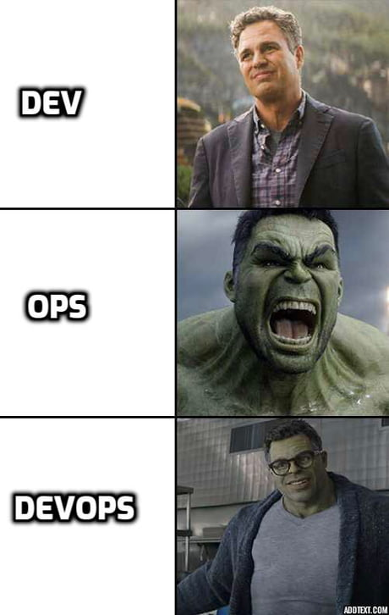

Slide 4
Event Agenda
Introduction to DevOps
Introduction to Git & GitHub
Introduction to Azure
GitHub Actions
Deploying to Azure
DevOps Pipeline

Slide 5

Notes:
Please adjust this slide to the end of your presentation
https://go.microsoft.com/fwlink/?linkid=2271366

Slide 6
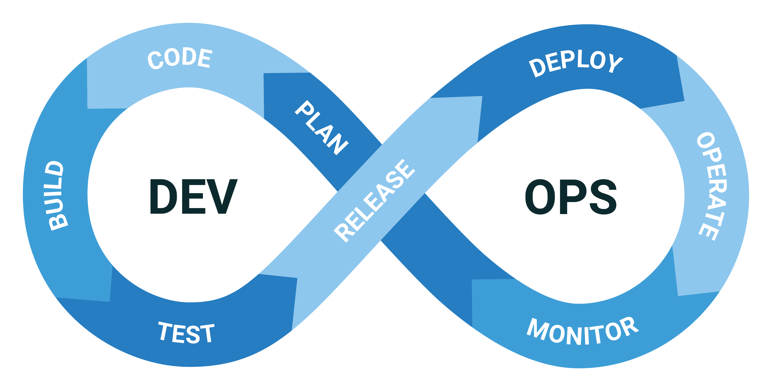
Introduction to DevOps

Slide 7
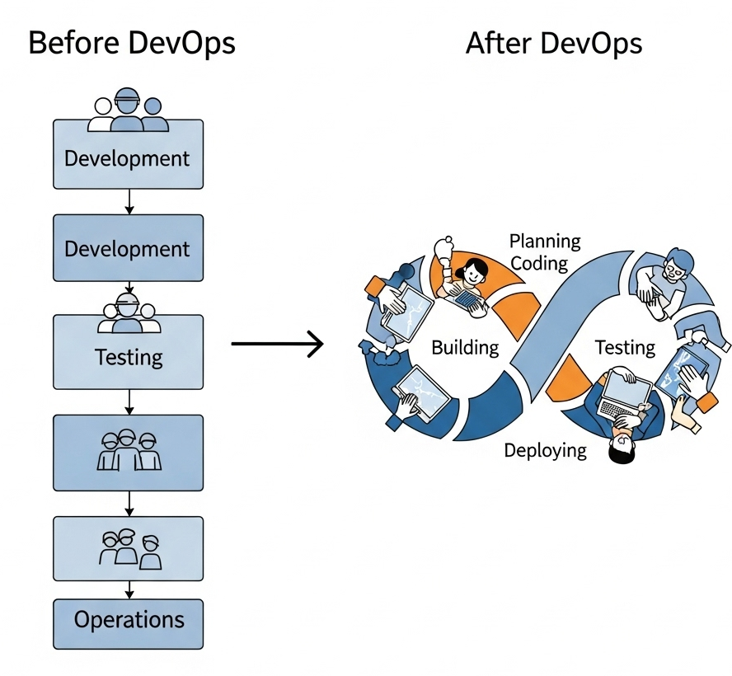
What is DevOps?
Dev + Ops = Development + Operations
Collaboration between development and IT teams
Key Principles:
CI/CD
Automation
Monitoring & Feedback
Benefits:
Faster delivery
Reliable systems
Shorter development cycles

Slide 8

Introduction to GitHub

Slide 9
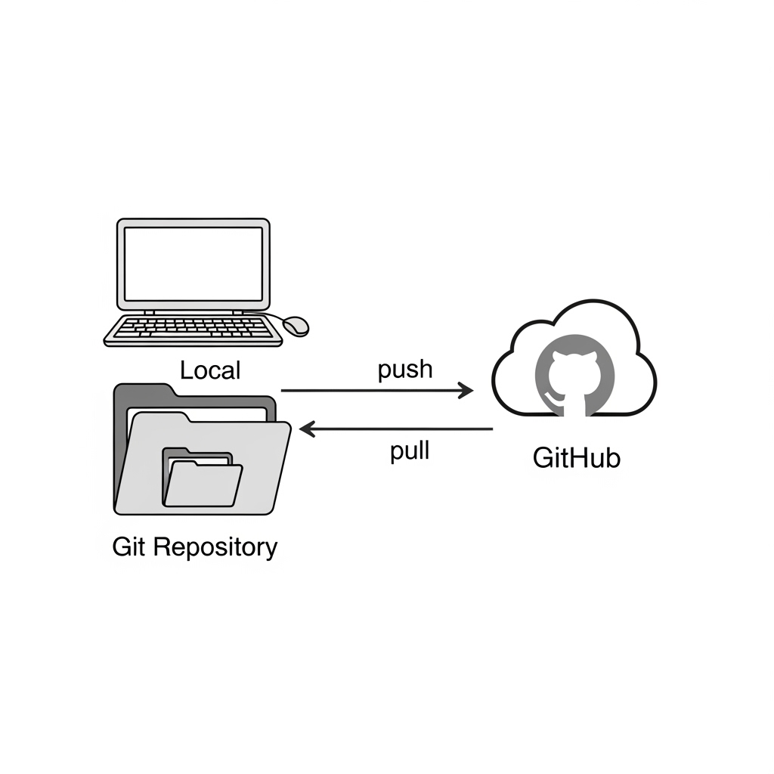
Git Basics
Version control: track changes in source code
Common commands: git init, add, commit, push, pull
GitHub Overview
Cloud-based Git repository hosting
Collaboration features (Pull Requests, Issues)

Slide 10

Introduction to Azure

Slide 11
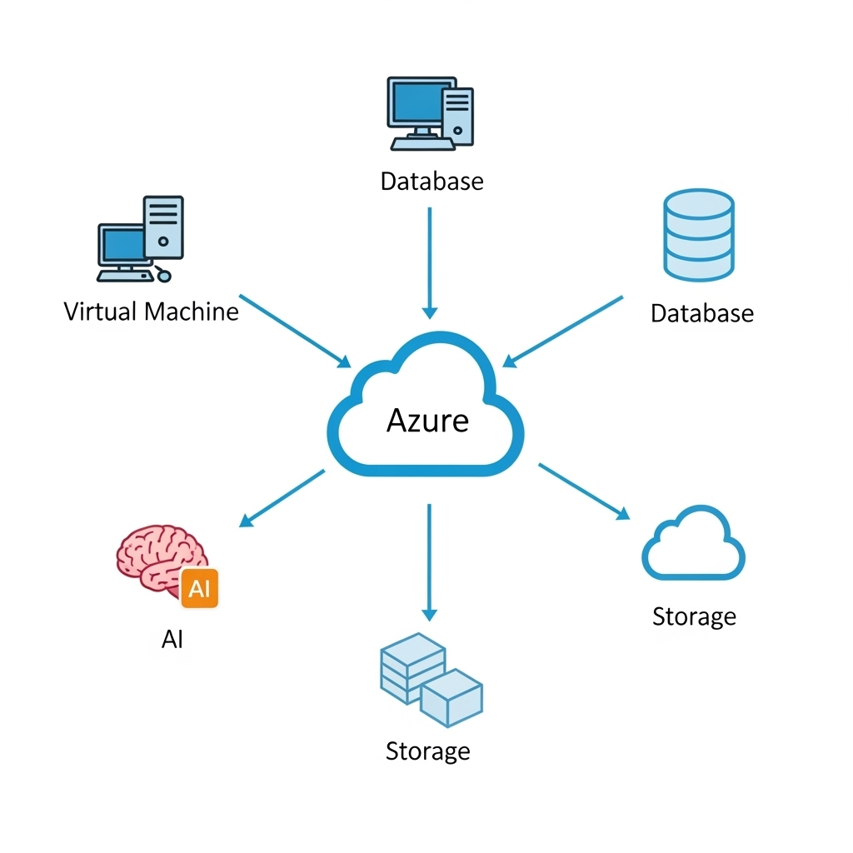
What is Azure?
Microsoft’s cloud computing platform
Offers IaaS, PaaS, SaaS
Core Services:
Azure App Services
Azure DevOps
Azure Repos, Pipelines
Why Azure in DevOps?
Integrated tools for CI/CD
Easy deployment and scalability

Slide 12


Slide 13
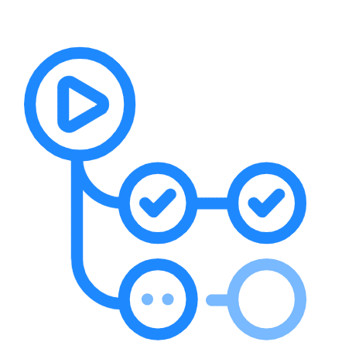
GitHub Actions & Pipeline

Slide 14
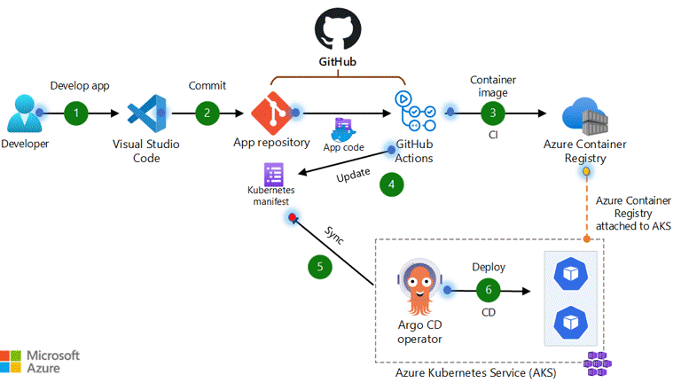

Slide 15


Slide 16
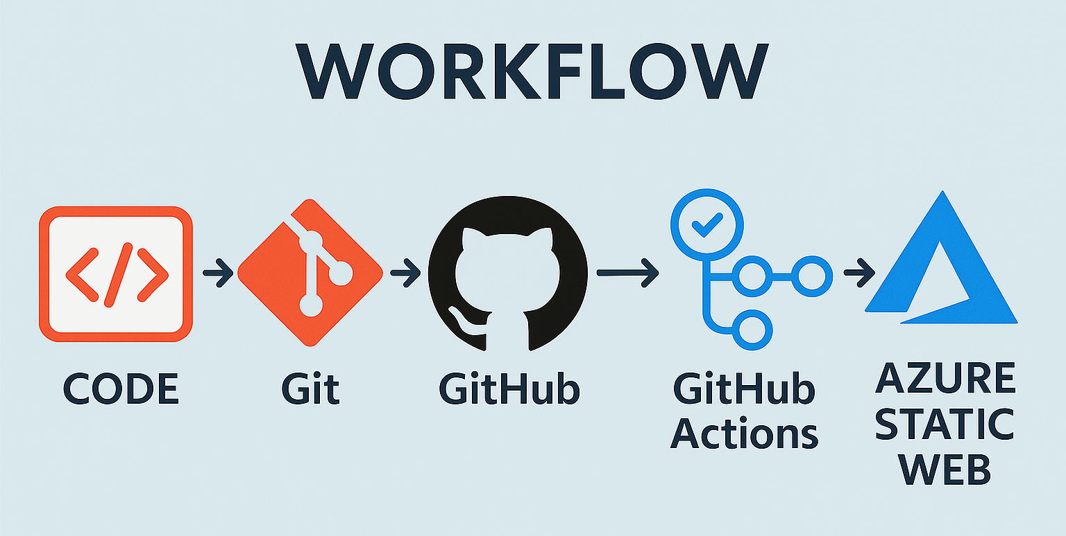

Slide 17


Slide 18
Thank You

